Slide 1
Cloudchain: a Blockchain-based Coopetition Differential Game Model for Cloud Computing
Mona Taghavi, Jamal Bentahar, Hadi Otrok, Kaveh Bakhtiyari
Concordia University, Montreal, Canada
Khalifa university, Abu dhabi, UAE
University of Duisburg-Essen, Duisburg, Germany
National university of malaysia, bangi, malaysia

Slide 2
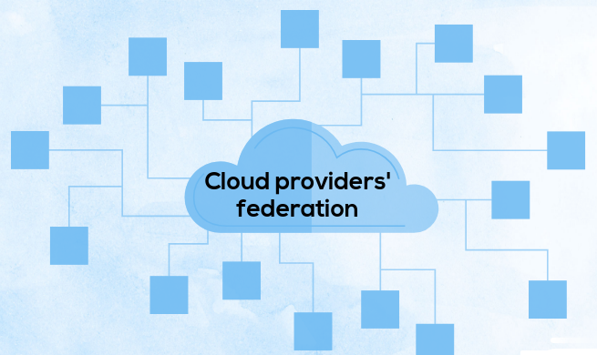
traditional cloud federations
The stability of a federation
A fair revenue sharing model
The presence of unknown and untrusted participants
The security and privacy issues

Slide 3
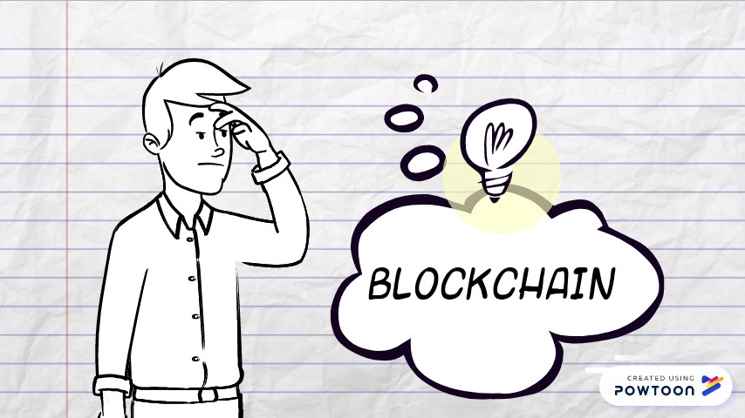


Slide 4
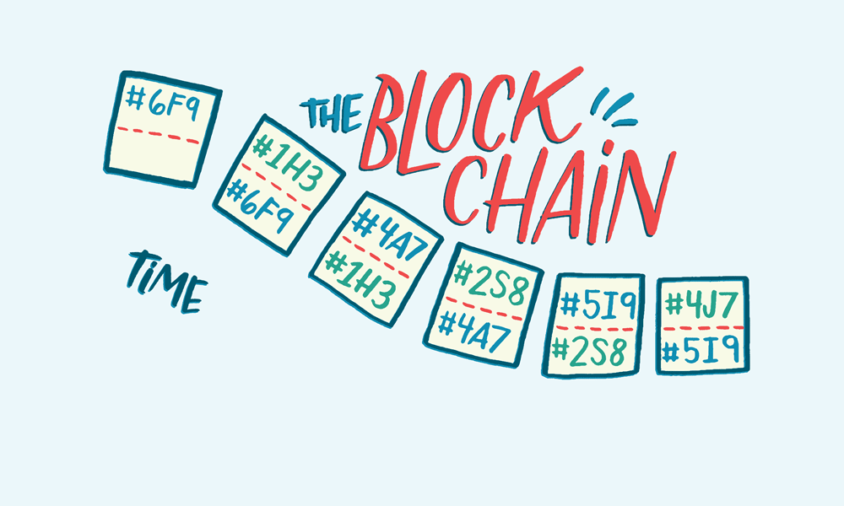
What is the blockchain?

Slide 5
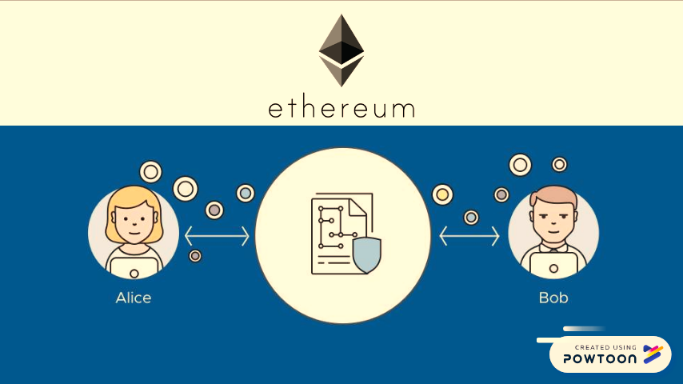
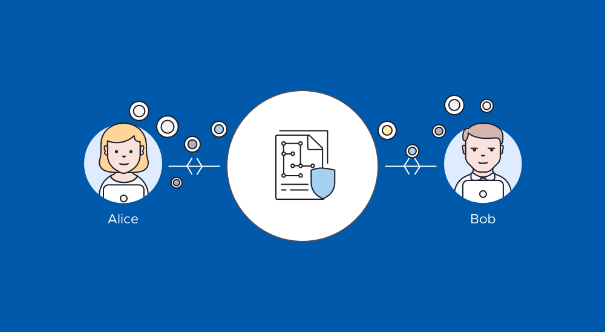
What is a smart contract?

Slide 6
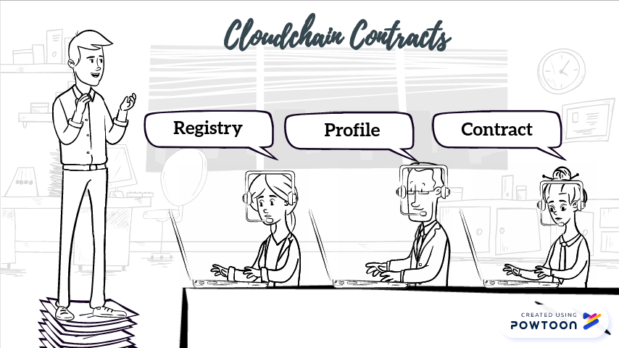


Slide 7
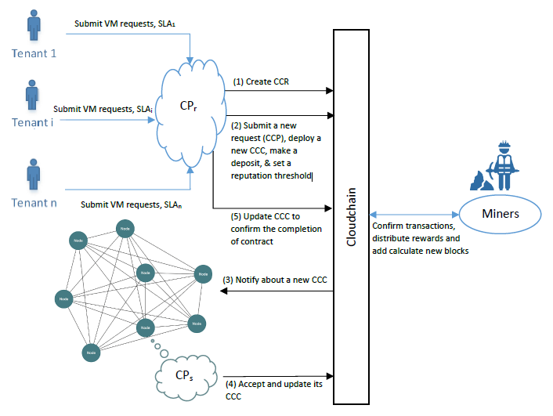

Slide 8
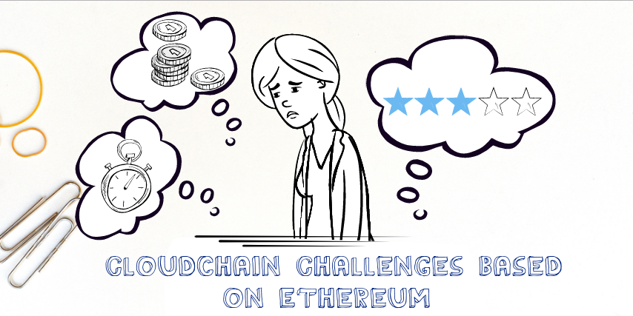

Slide 9
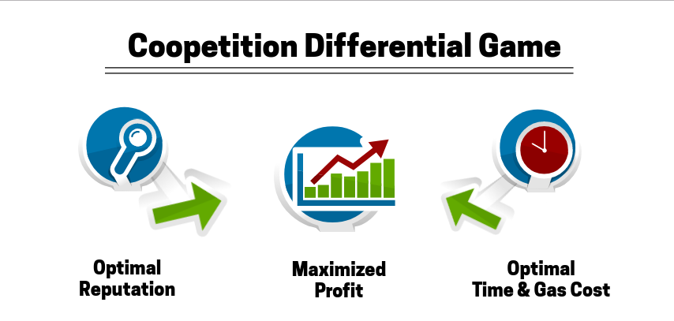

Slide 10
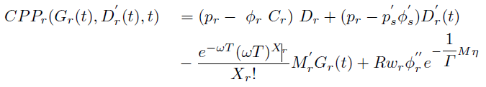
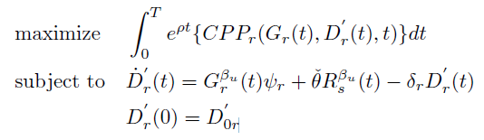
Optimization problem of
Cloud provider as a requester

Slide 11
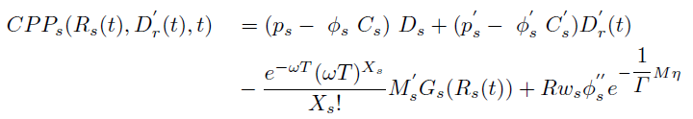
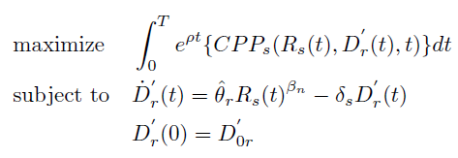
Optimization problem of
Cloud provider as a supplier

Slide 12


Optimal Gas cost and reputation value

Slide 13
Implementation
Solidity (version 0.4.24)
  https://github.com/kavehbc/Cloudchain
  Minimum consumption of gas per each transaction
  Tested using remix

Slide 14




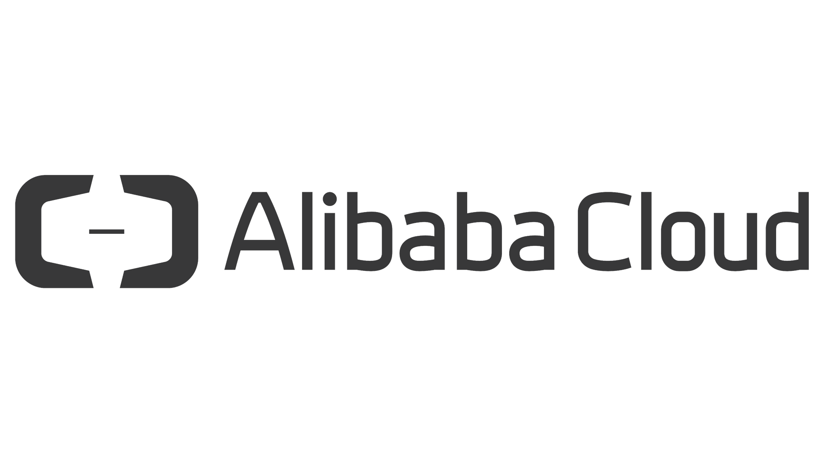
Simulated cloud service trading among real-world providers

Slide 15
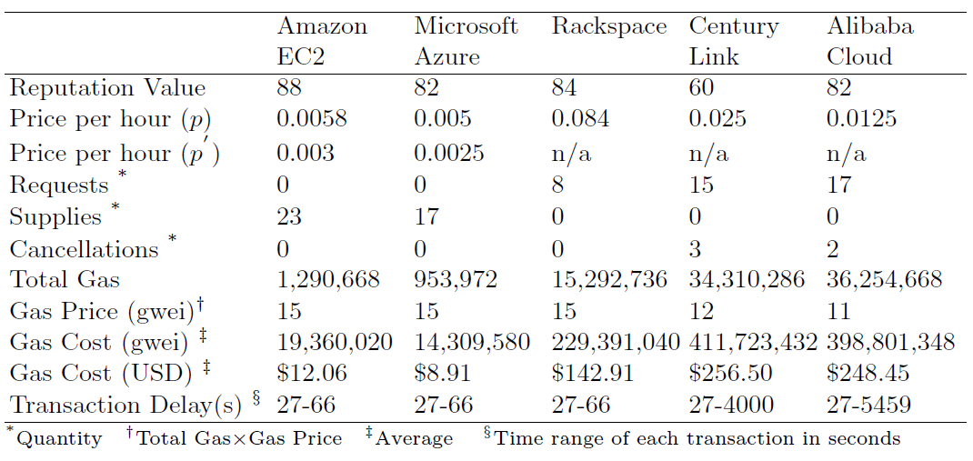
Provider's estimated transactions and costs on Cloudchain

Slide 16
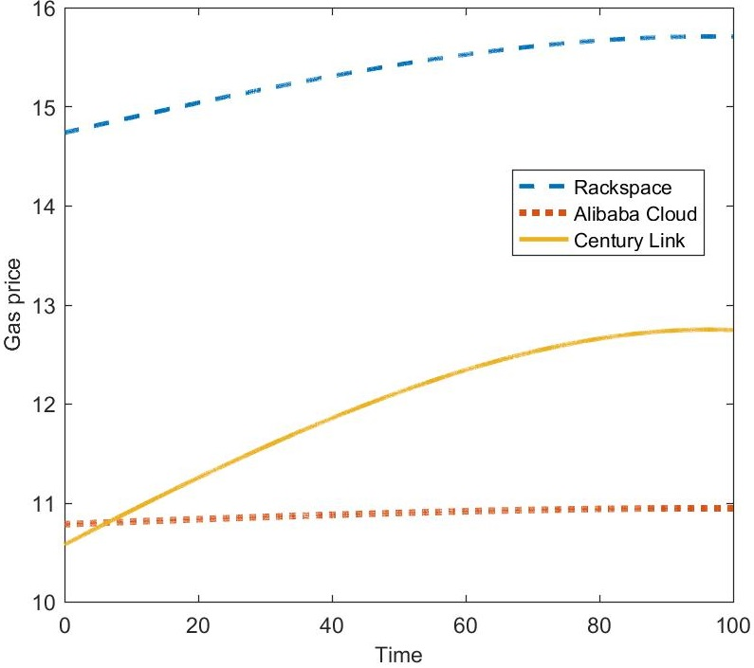
Optimal gas price of the tree cloud requesters

Slide 17
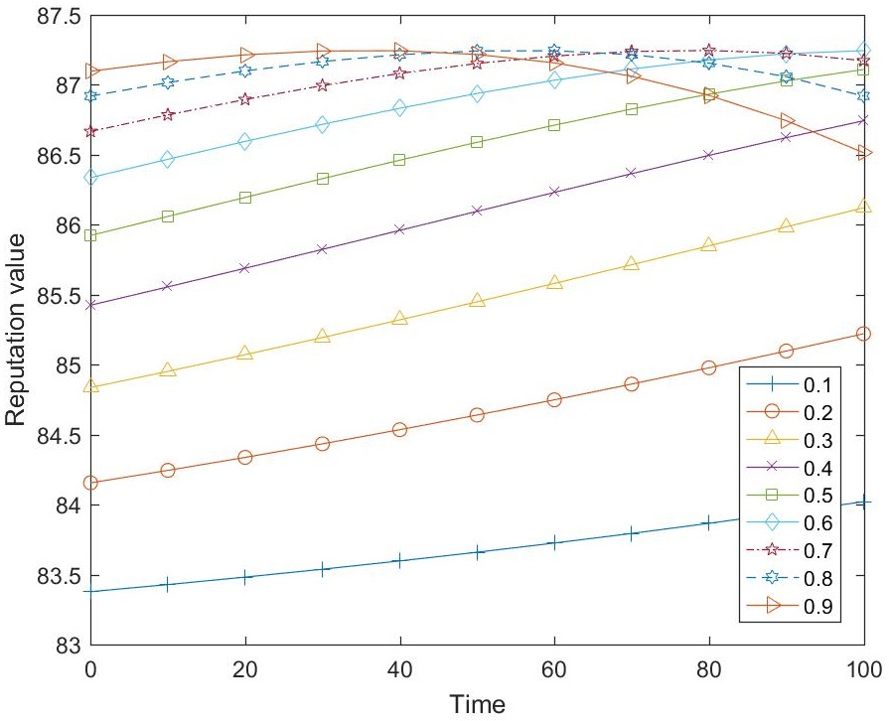
Microsoft's optimal reputation

Slide 18
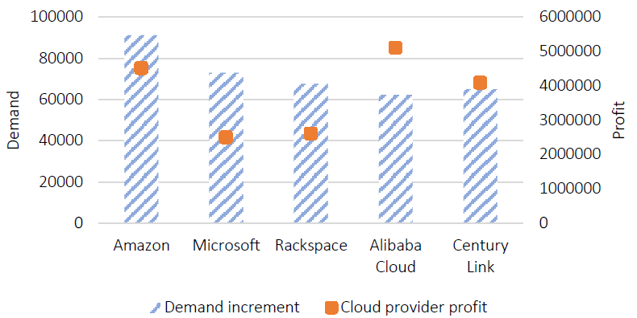
Average of cloud providers' profit and demands' evolution in Nash Equilibrium

Slide 19
